Slide 1

On the Spatial Filter Design in End-to-end Sequential Beamforming Pipeline
Yi Luo
Tencent AI Lab

Slide 2
Outline
Beamforming: recap
E2E sequential beamforming for source separation: a general pipeline
Generalized Wiener filter (GWF): on the design of spatial filter in sequential beamforming
Experiments, results, analysis, and discussions

Slide 3
Beamforming
(Linear) Spatial filters applied to multi-channel observations
Enhance signal from a certain (target) direction
Satisfy certain constraints: MVDR, MMSE, Max-SNR, etc.
Requires the extraction of (spatial) features of the target signal
Steering vector: directional information
Spatial covariance matrix: solve optimization problems
Neural beamformers: use neural network (separators) to extract features
Mask-based beamformer¹: T-F masks for target signal -> masked spectrograms -> spatial covariance (and steering vector)
Output-based beamformer²: Waveforms for target signal -> spectrograms -> spatial covariance
¹Heymann, Jahn, Lukas Drude, and Reinhold Haeb-Umbach. "Neural network based spectral mask estimation for acoustic beamforming." 2016 IEEE International Conference on Acoustics, Speech and Signal Processing (ICASSP). IEEE, 2016.
²Ochiai, Tsubasa, et al. "Beam-TasNet: Time-domain audio separation network meets frequency-domain beamformer." 2020 IEEE International Conference on Acoustics, Speech and Signal Processing (ICASSP). IEEE, 2020.

Slide 4
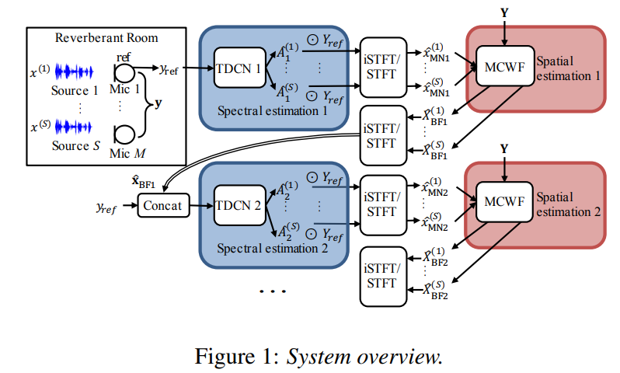
Sequential Beamforming
Standard beamforming: pre-separation + beamforming
Sequential beamforming: multiple rounds of separation + beamforming
Beamforming outputs are used as auxiliary / additional information for next round of (neural) separation
Typically by feature concatenation
Separation outputs are then passed to another round of beamforming
Wang, Zhong-Qiu, et al. "Sequential multi-frame neural beamforming for speech separation and enhancement." 2021 IEEE Spoken Language Technology Workshop (SLT). IEEE, 2021.

Slide 5
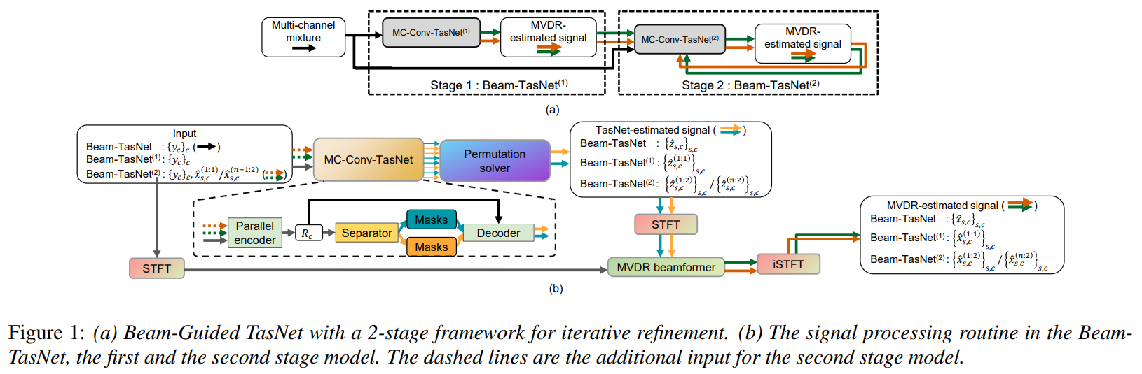
Sequential Beamforming
Various choices for separator / beamformer:
Separator: time-domain or frequency-domain
Beamformer: MVDR / MPDR / MCWF / GEV / …
Chen, Hangting, and Pengyuan Zhang. "Beam-Guided TasNet: An Iterative Speech Separation Framework with Multi-Channel Output." arXiv preprint arXiv:2102.02998 (2021).

Slide 6
Choice of Beamformer
Beamformer’s output might not be directly used as the system’s output
Either the output from the neural separator or the beamformer can be selected as the actual output
When used as an auxiliary / additional feature to the separator, the beamformer operation becomes a feature extractor
Which beamformer to use when used for feature extraction?
Numerically stable in E2E pipeline, where the beamformer contributes to backprop
Better to be jointly optimized with the separator

Slide 7
Generalized Wiener Filter
Generalized Wiener Filter (GWF) : beyond frequency-domain MCWF
Idea: find a better representation than STFT when calculating the beamforming coefficients
Similar to TasNet ver.1, where 1D convolutional layer was used to replace STFT
Use a real-valued representation instead of a complex-valued one
Maintain the pros of conventional beamformers (e.g., well-defined by an constrained optimization problem) and E2E pipeline (e.g., optimized in a data-driven way)

Slide 8
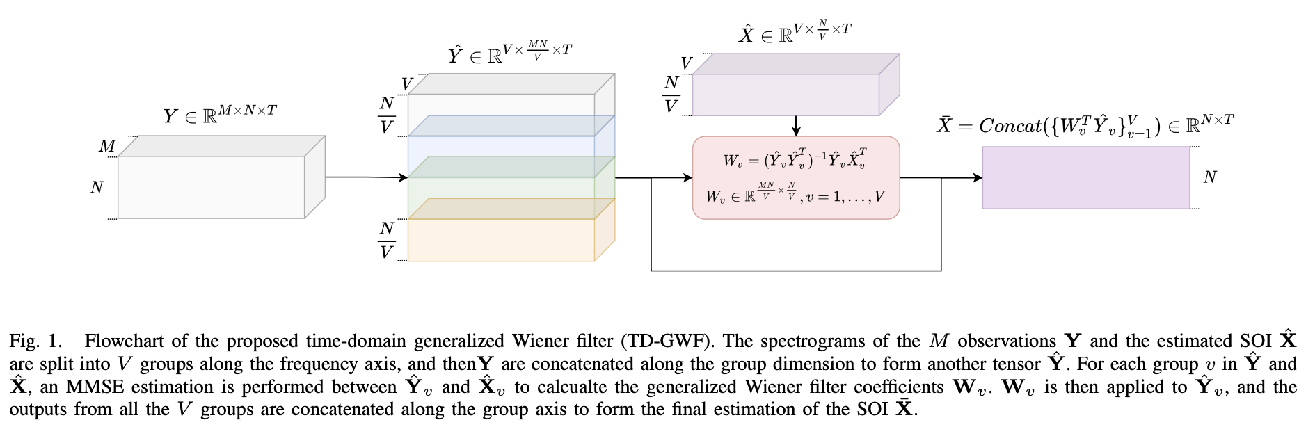
Generalized Wiener Filter

Slide 9
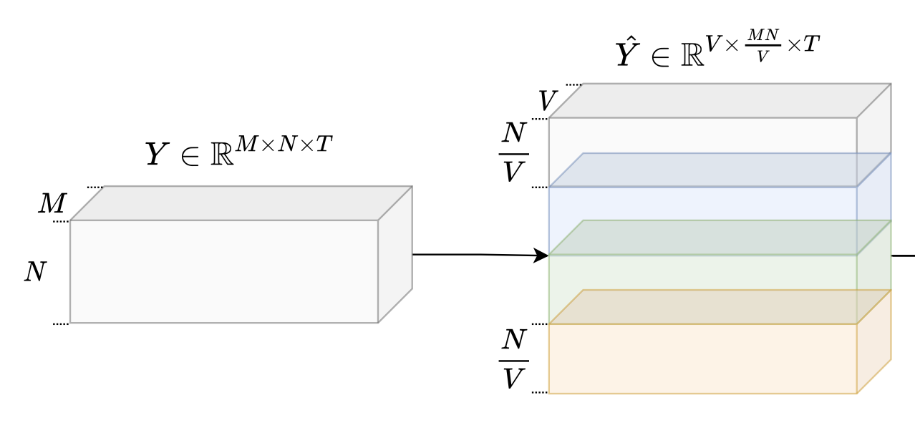
Generalized Wiener Filter
Encoding: 1D convolution for all channels
Replace STFT
Windowing, and transform 1D windows to 2D features (N-dimensional)
Grouping: split the feature to V (nonoverlapped) groups
Concatenation: concatenate each group of sub-features in all channels along the feature dimension

Slide 10
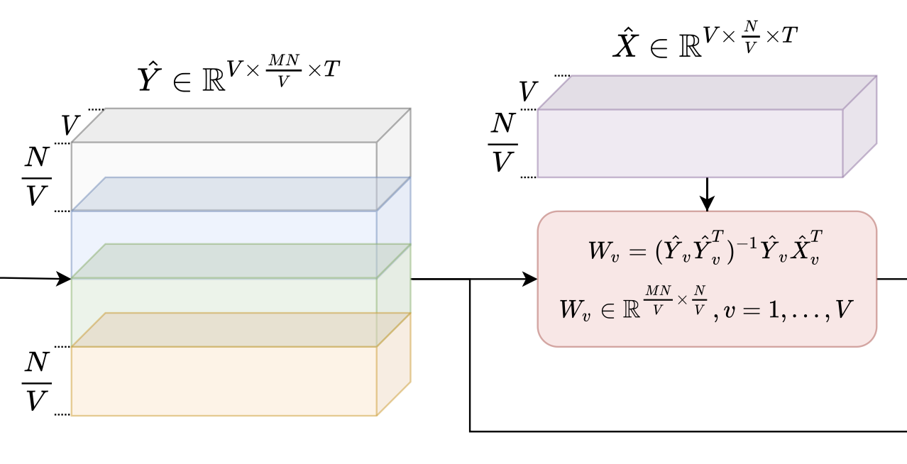
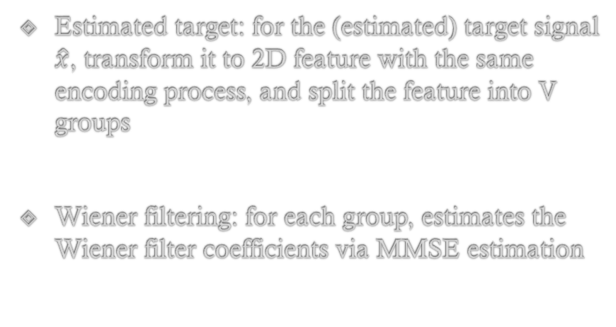
Generalized Wiener Filter
Estimated target: for the (estimated) target signal $\hat{x}$, transform it to 2D feature with the same encoding process, and split the feature into V groups
Wiener filtering: for each group, estimates the Wiener filter coefficients via MMSE estimation

Slide 11
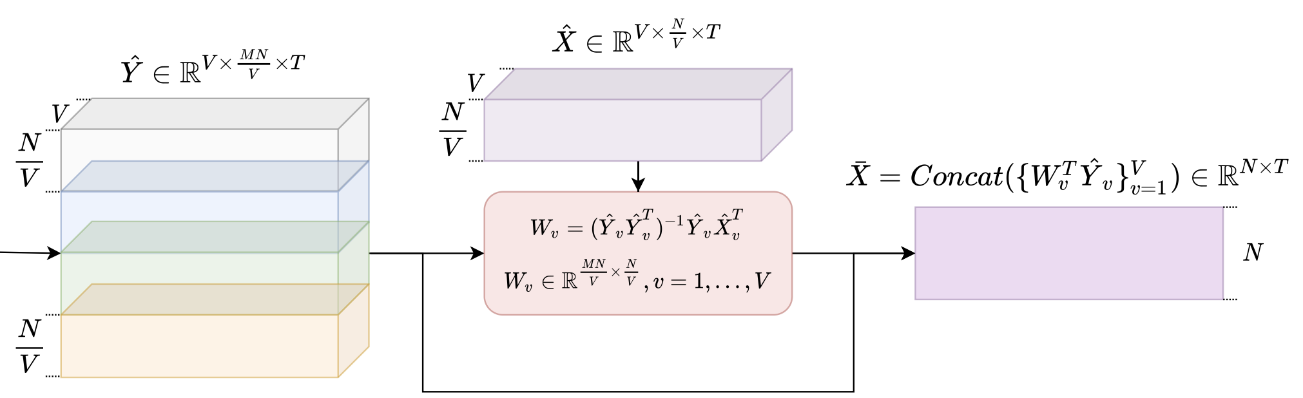
Generalized Wiener Filter
Apply Wiener filter to (concatenated) 2D features of all channels
Decoding: transform the 2D representation back to a 1D waveform

Slide 12
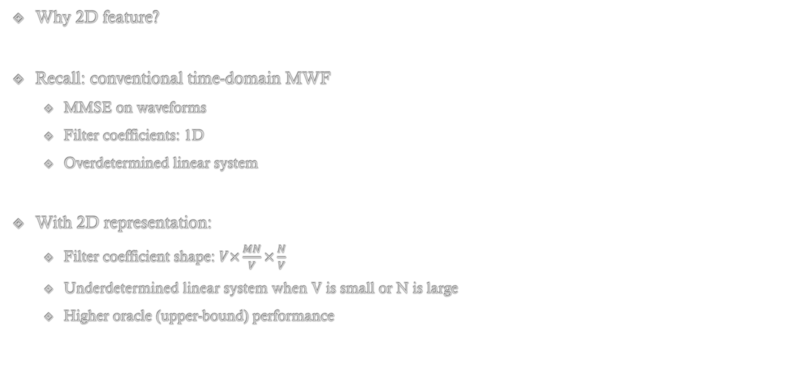
Generalized Wiener Filter
Why 2D feature?
Recall: conventional time-domain MWF
MMSE on waveforms
Filter coefficients: 1D
Overdetermined linear system
With 2D representation:
Filter coefficient shape: $V×\frac{MN}{V}×\frac{N}{V}$
Underdetermined linear system when V is small or N is large
Higher oracle (upper-bound) performance

Slide 13
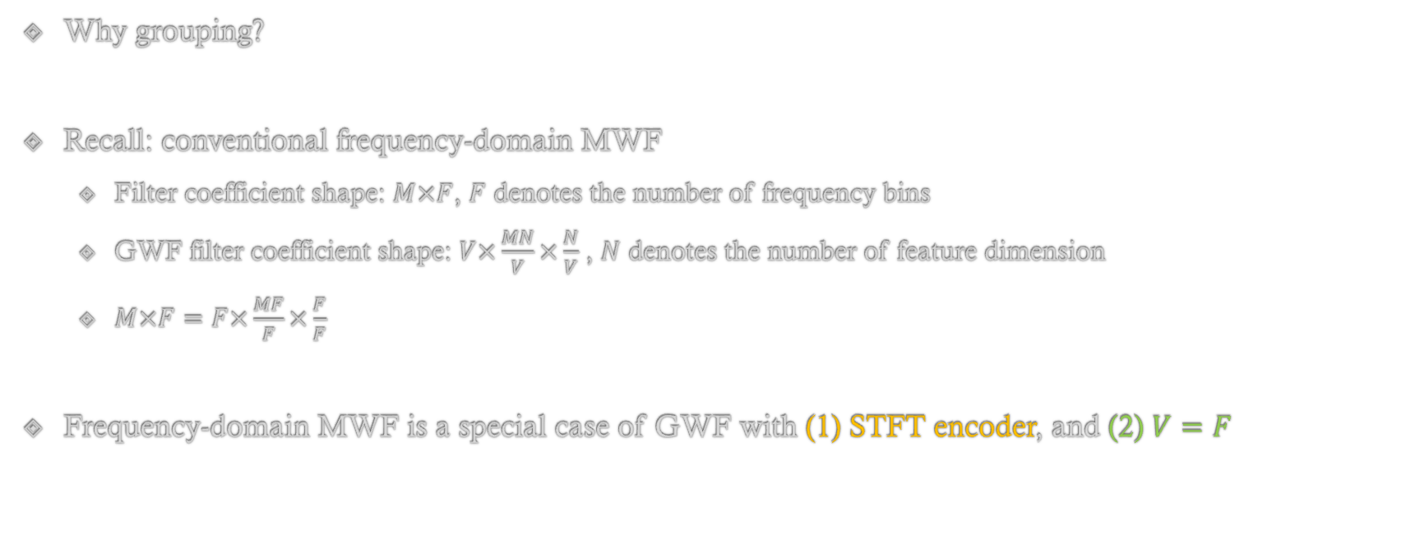
Generalized Wiener Filter
Why grouping?
Recall: conventional frequency-domain MWF
Filter coefficient shape: $M×F$, $F$ denotes the number of frequency bins
GWF filter coefficient shape: $V×\frac{MN}{V}×\frac{N}{V}$ , $N$ denotes the number of feature dimension
$M×F=F×\frac{MF}{F}×\frac{F}{F}$
Frequency-domain MWF is a special case of GWF with (1) STFT encoder, and (2) $V=F$

Slide 14
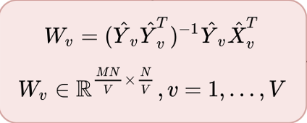
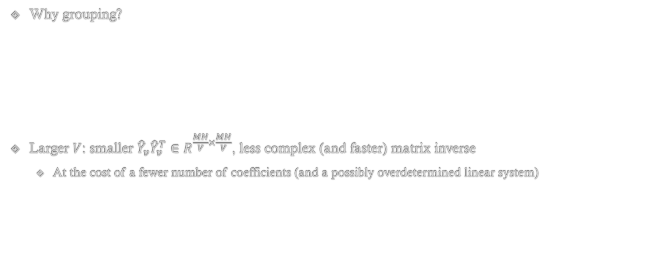
Generalized Wiener Filter
Why grouping?
Larger $V$: smaller ${\hat{Y}}_{v}{\hat{Y}}_{v}^{T}∈R^{\frac{MN}{V}×\frac{MN}{V}}$, less complex (and faster) matrix inverse
At the cost of a fewer number of coefficients (and a possibly overdetermined linear system)

Slide 15
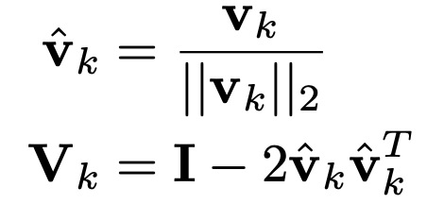
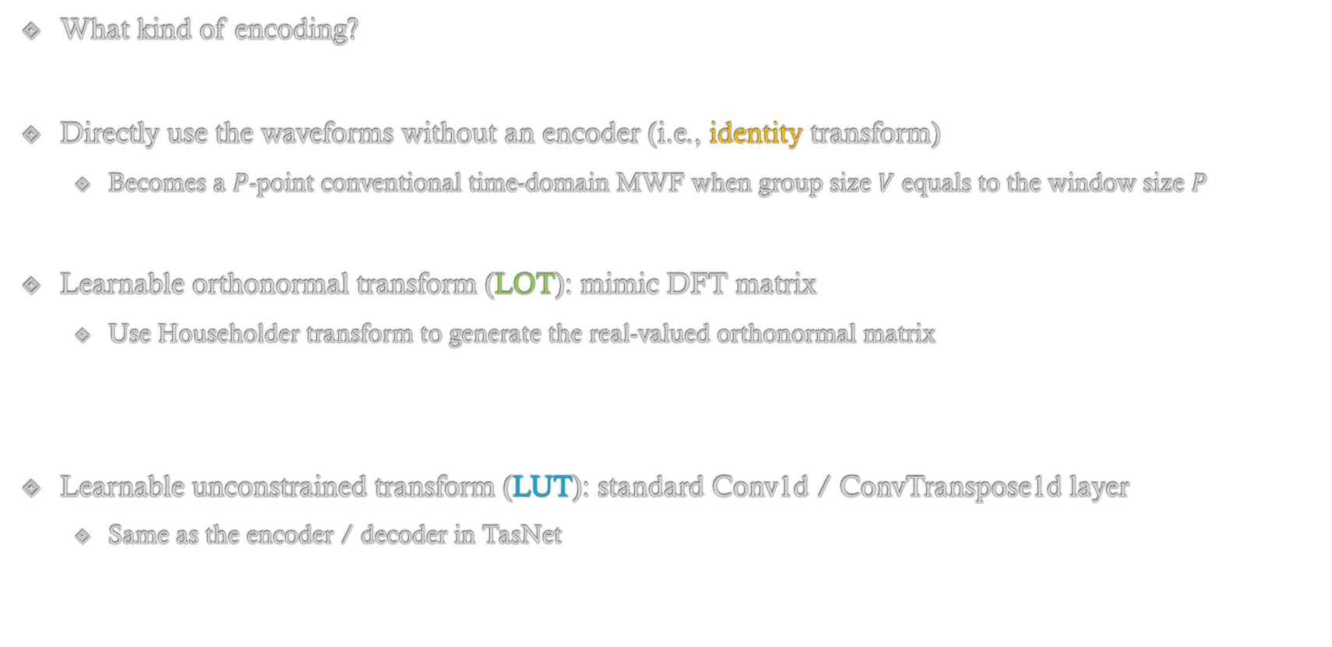
Generalized Wiener Filter
What kind of encoding?
Directly use the waveforms without an encoder (i.e., identity transform)
Becomes a $P$-point conventional time-domain MWF when group size $V$ equals to the window size $P$
Learnable orthonormal transform (LOT): mimic DFT matrix
Use Householder transform to generate the real-valued orthonormal matrix
Learnable unconstrained transform (LUT): standard Conv1d / ConvTranspose1d layer
Same as the encoder / decoder in TasNet

Slide 16
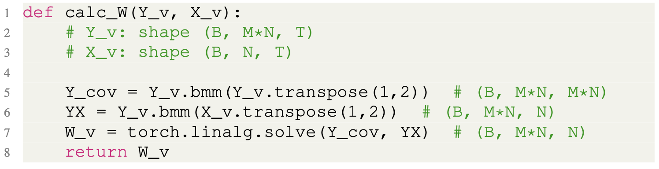
Generalized Wiener Filter
Implementation: 3 lines of codes for filter coefficient estimation

Slide 17
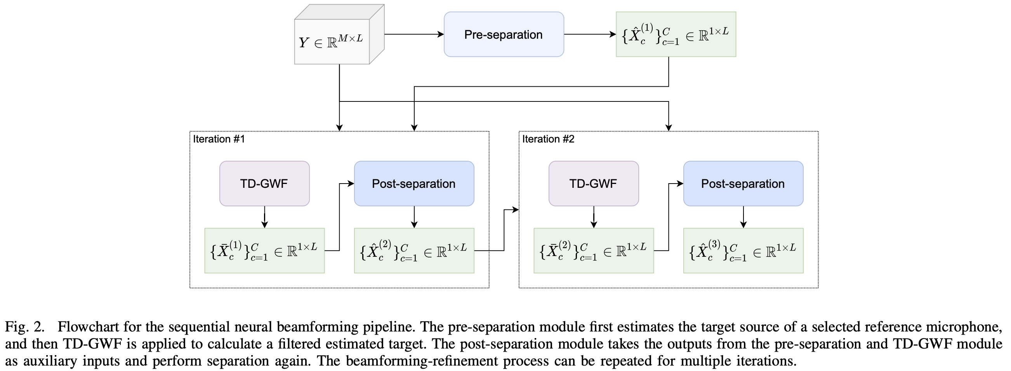
Generalized Wiener Filter
GWF in sequential beamforming: directly replace conventional frequency-domain beamformers

Slide 18
Experiment Configuration
Experiment configuration: multi-channel 2-speaker separation under reverberation and noise
Same dataset as FaSNet-TAC¹
Both circular and ad-hoc arrays ( 6 mics)
Separator network: multiple baselines
DPRNN-TasNet (single-channel)
MC-TasNet
FaSNet-TAC
iFaSNet
¹Luo, Yi, et al. "End-to-end microphone permutation and number invariant multi-channel speech separation." 2020 IEEE International Conference on Acoustics, Speech and Signal Processing (ICASSP). IEEE, 2020.

Slide 19
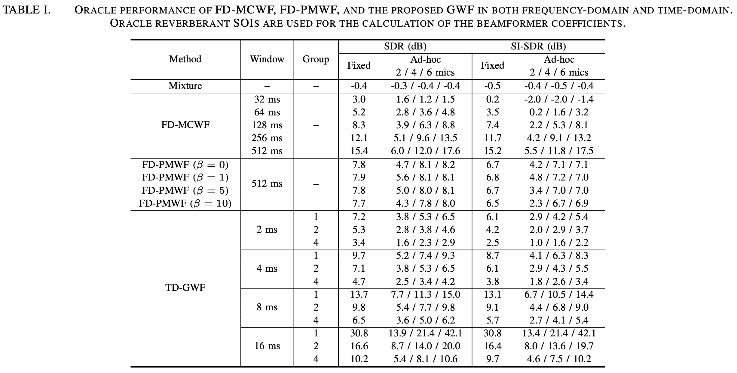
Results
Oracle performance of various beamformers: use ideal targets to calculate the filter coefficients

Slide 20
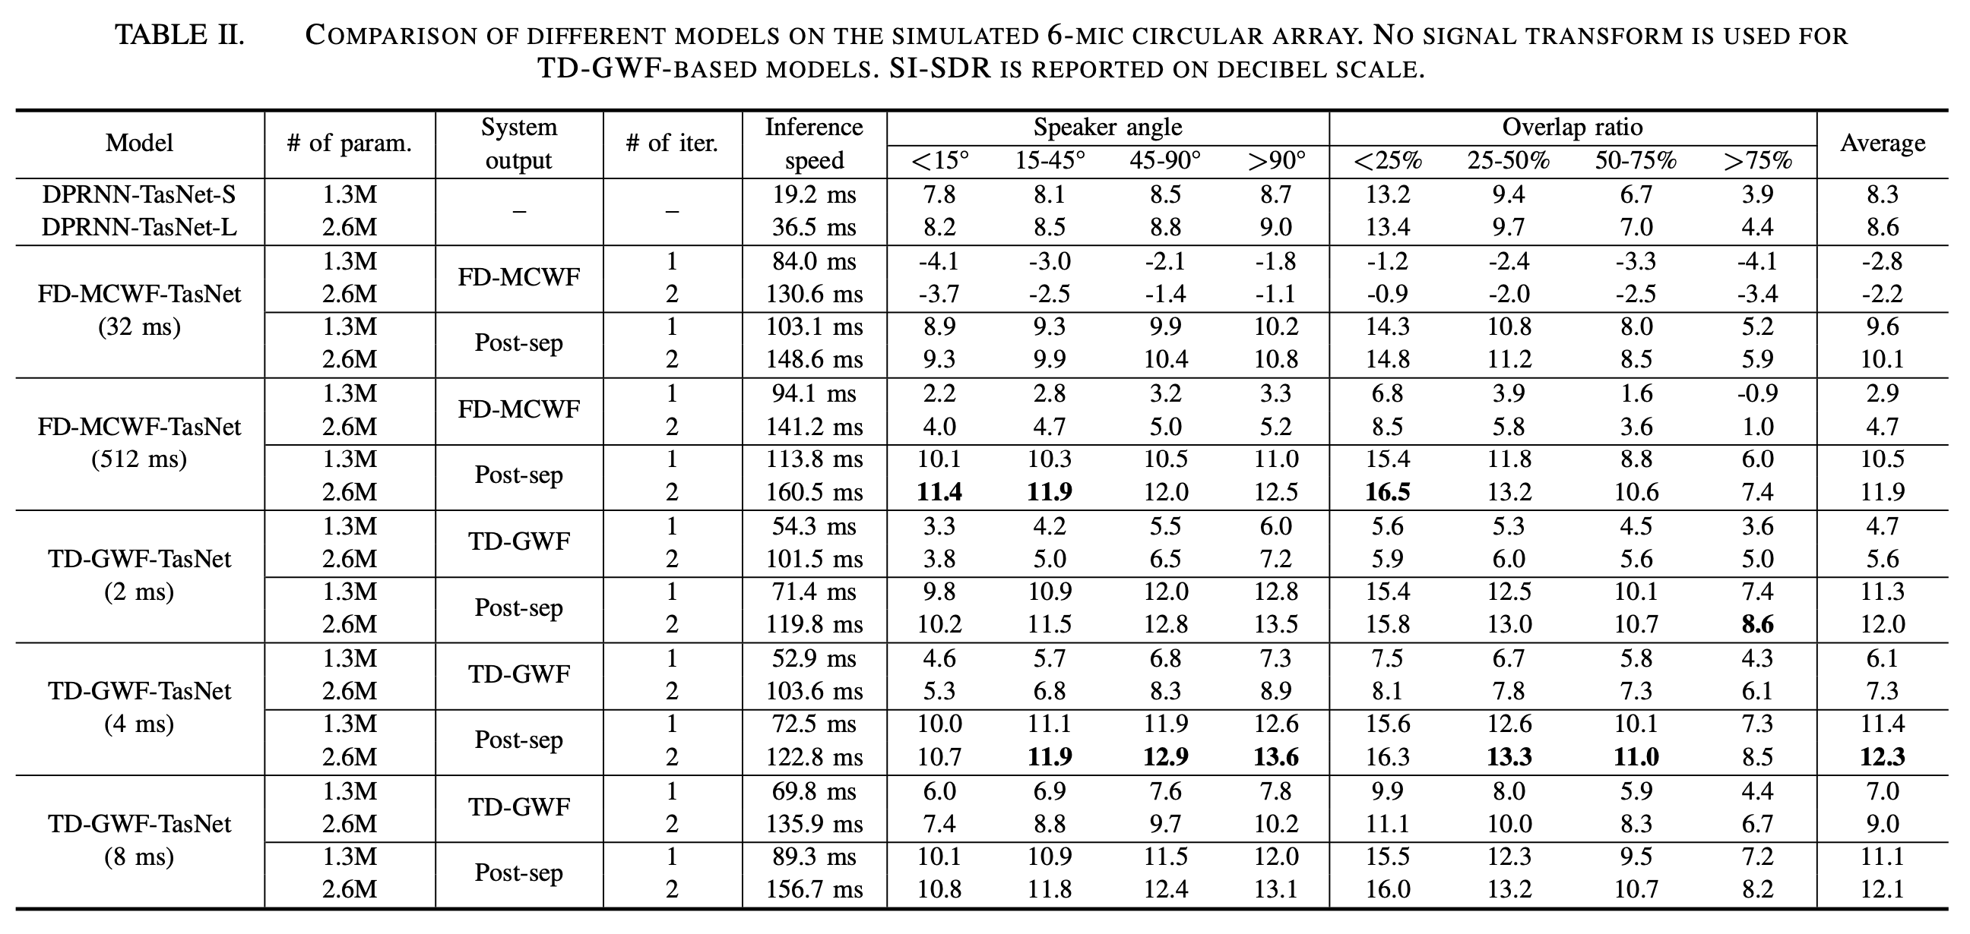
Results
Sequential beamforming: performance and speed with DPRNN-TasNet as separator

Slide 21
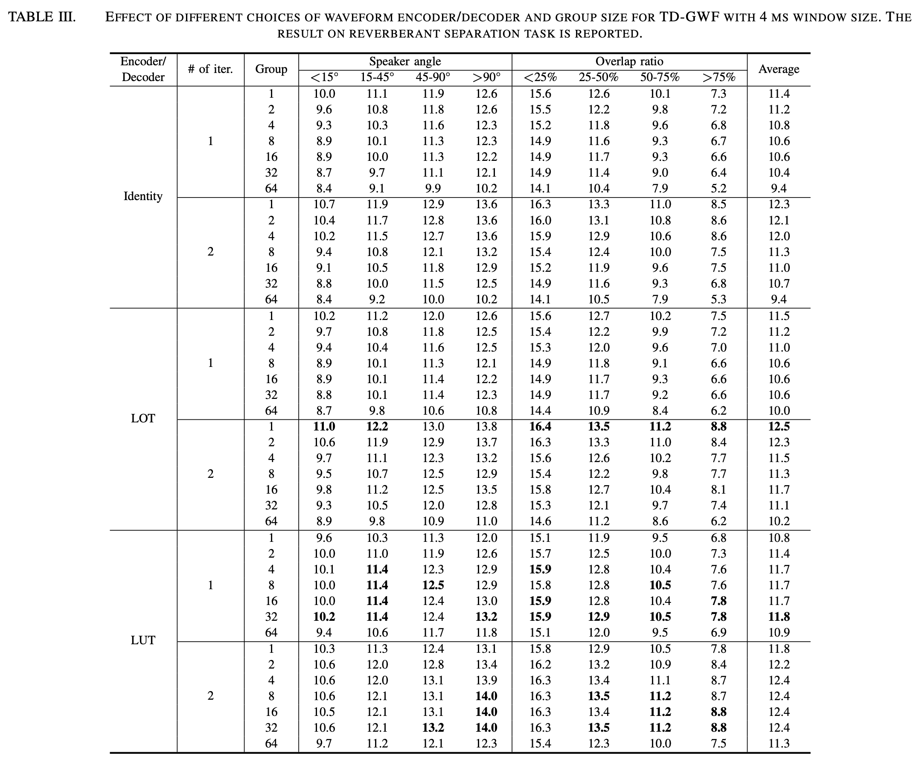
Results
Effect of encoder / decoder type and group size

Slide 22
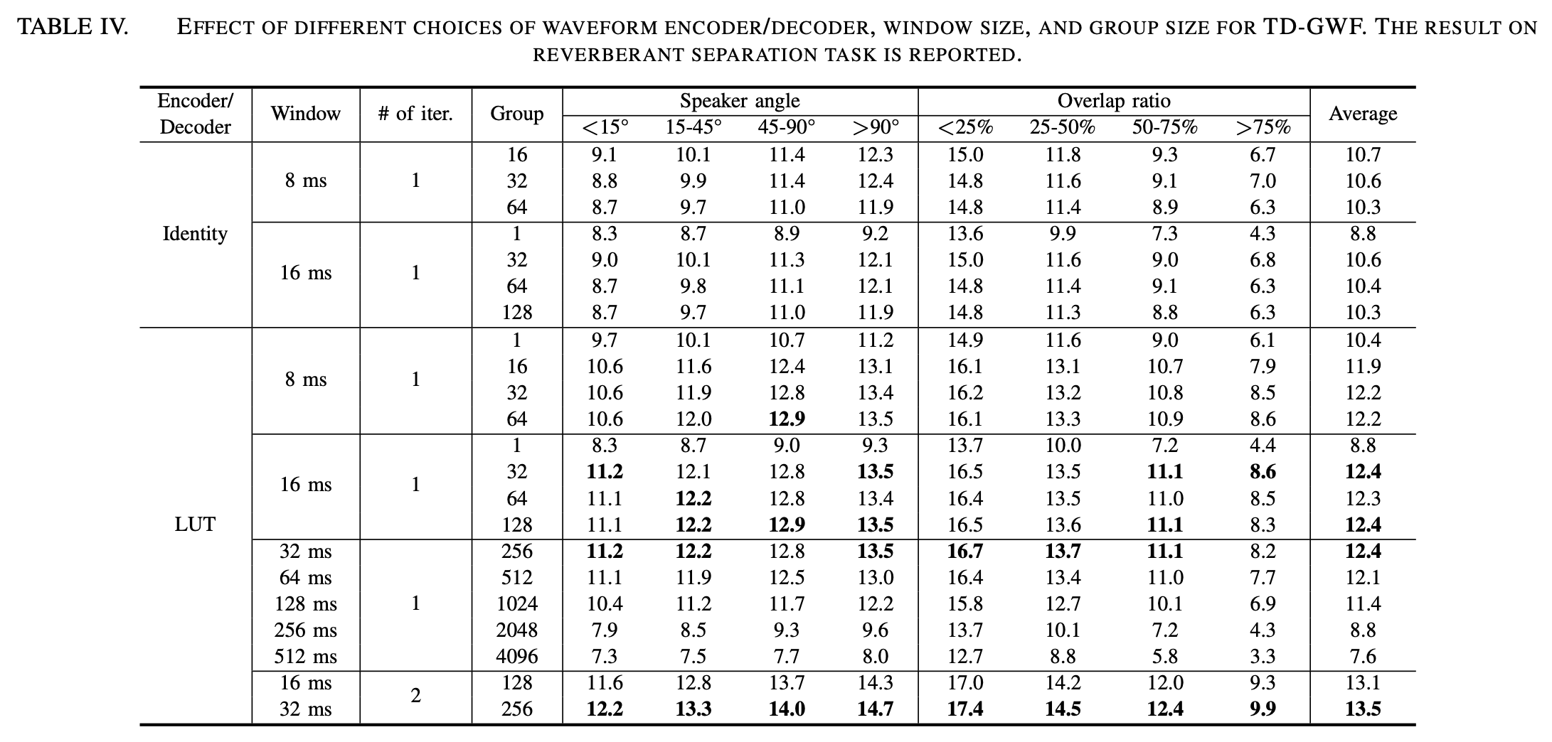
Results
Effect of window size and group size

Slide 23
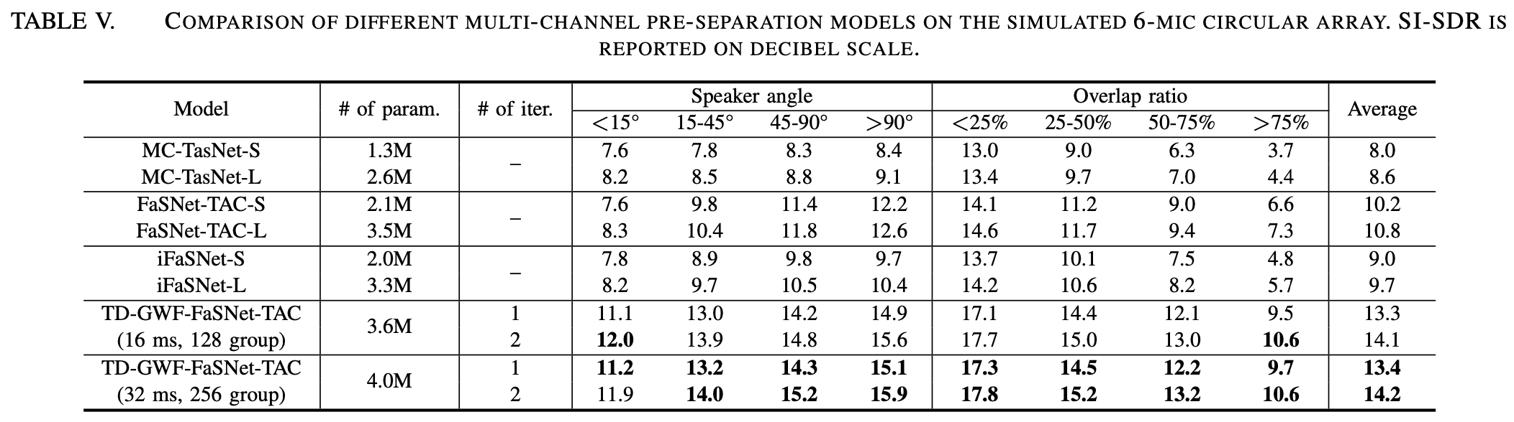
Results
Effect of different separators: circular array

Slide 24
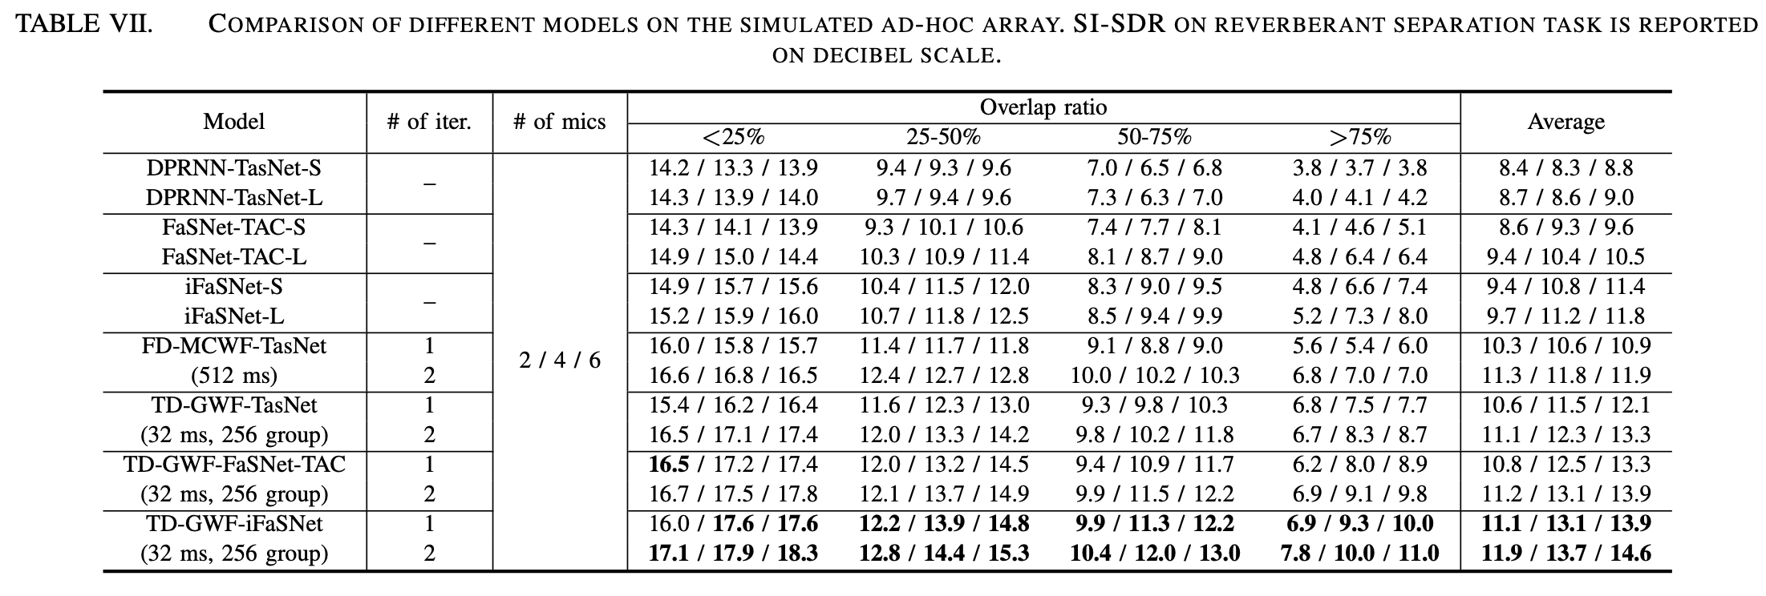
Results
Effect of different separators: ad-hoc array

Slide 25
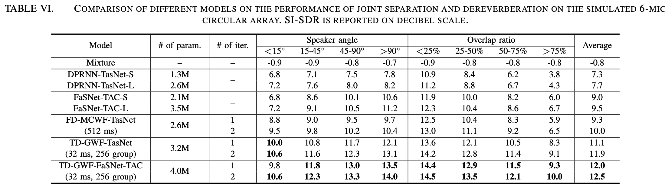
Results
Effect of different separators in joint separation and dereverberation task: circular array

Slide 26
Conclusion
GWF: an extension of conventional frequency-domain beamformers in sequential beamforming pipeline
E2E optimization of signal encoder / decoder
Real-valued, numerically stable, easy to implement
Use together with any type of separator

